Slide 1
Customer Personality Analysis Using Python
Industry: Business/Marketing Industry
Dataset: Marketing Campaign Dataset
Source: https://www.kaggle.com/datasets/imakash3011/customer-personality-analysis
Date: 10th May 2023

Slide 2


About Data
The data contained in the dataset is vital for a business to have an understanding about their customers, making it easy for them to modify products according to customer age, locations, behavior among others, plan marketing strategies and address concerns of customers, according to the findings in the data.
There are 29 columns and 2240 rows in the data set
Demographic information
(ID,Year_Birth,Education,Marital_Status,Income,Kidhome,Teenhome, Customer Recency, Complain)
Product level information
MntWines,MntFruits,MntMeatProducts,MntFishProducts,MntSweetProducts,MntGoldProds
Promotion level information
NumDealsPurchases,AcceptedCmp1,AcceptedCmp2,AcceptedCmp3,AcceptedCmp4,AcceptedCmp5,Response
Purchase method
NumWebPurchases,NumCatalogPurchases,NumStorePurchases,NumWebVisitsMonth

Slide 3
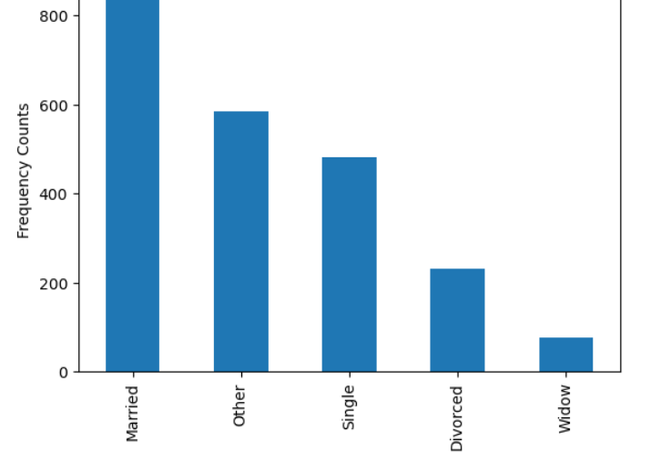
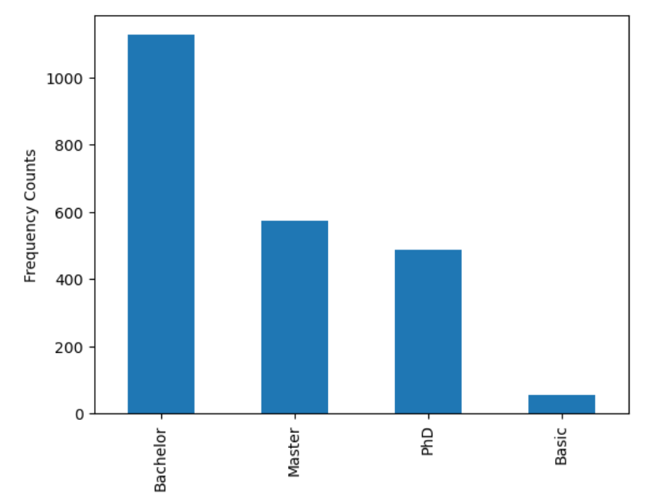
Feature Engineering
1.07% data is missing in income field. Dropping those records.
Age has been calculated from Year_Birth.
Standardizing the values in the Education column to print only 'Basic', 'Bachelor’,
'Master' and 'PHD' by setting 'Graduation' to 'Bachelor', and '2n Cycle' to 'Master’
standardize the values in the Marital_Status column to print only 'Single', 'Married’,'Divorced’,
'Widow' and 'Other' by setting 'Alone' to single and 'Together', 'Absurd’ & 'YOLO' to 'Other
Feature scaling and dimensionality reduction has been applied on the data

Slide 4
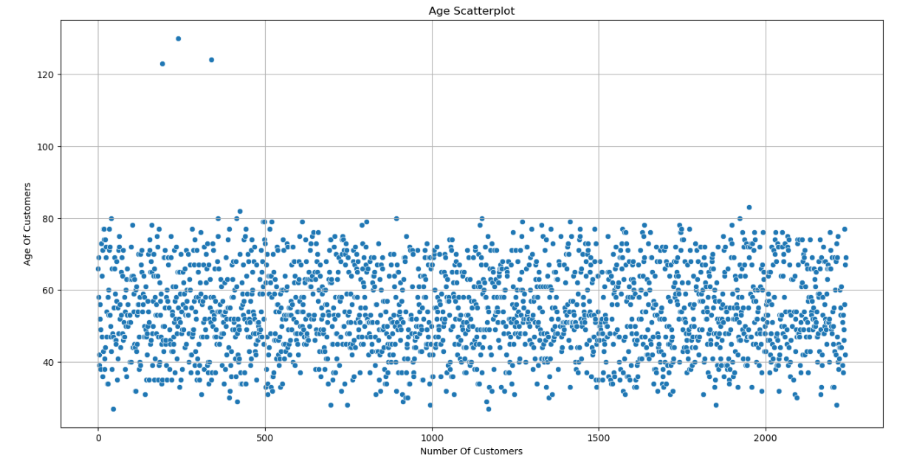
Outliers
There are 3 ages in our dataset that are extremely larger than the others.
Age above 120 years

Slide 5
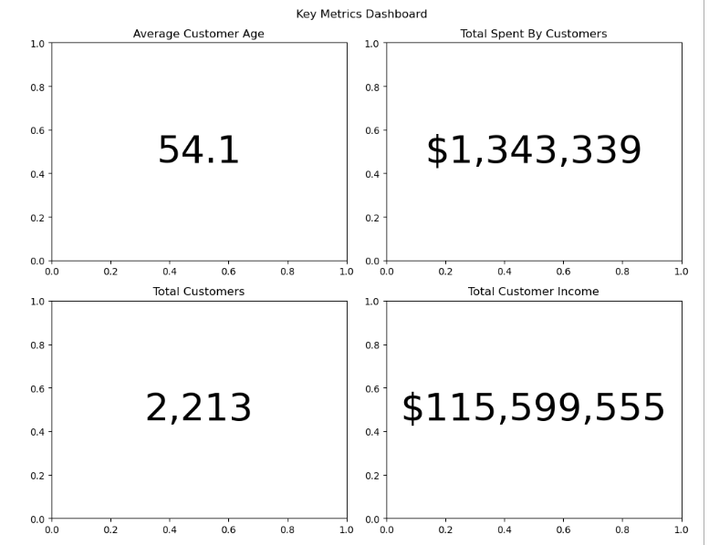
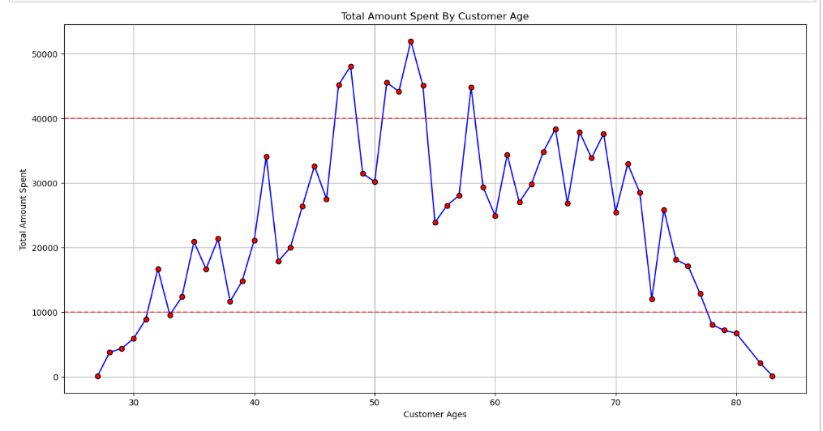
Key Metrics Dashboard

Slide 6
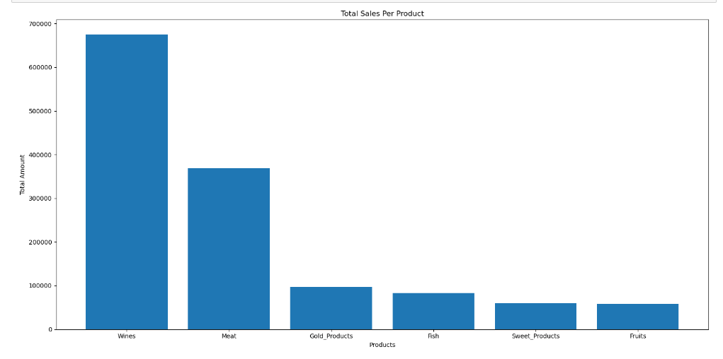
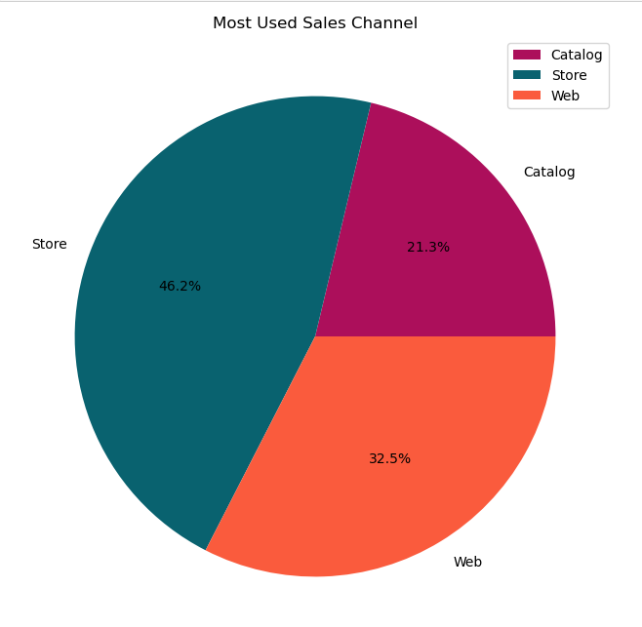
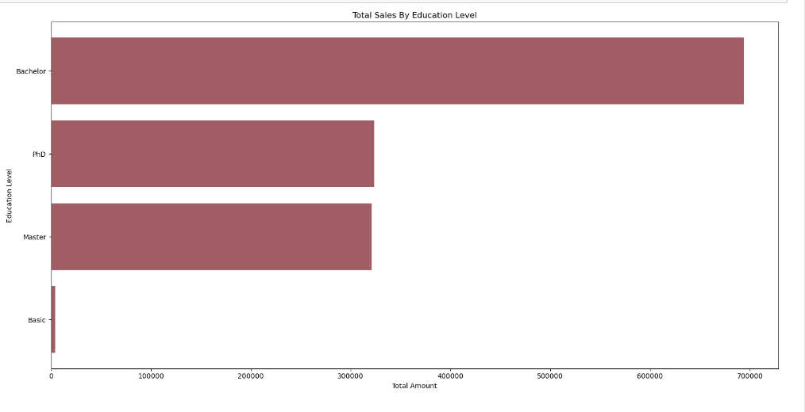
Total Spends by categories

Slide 7
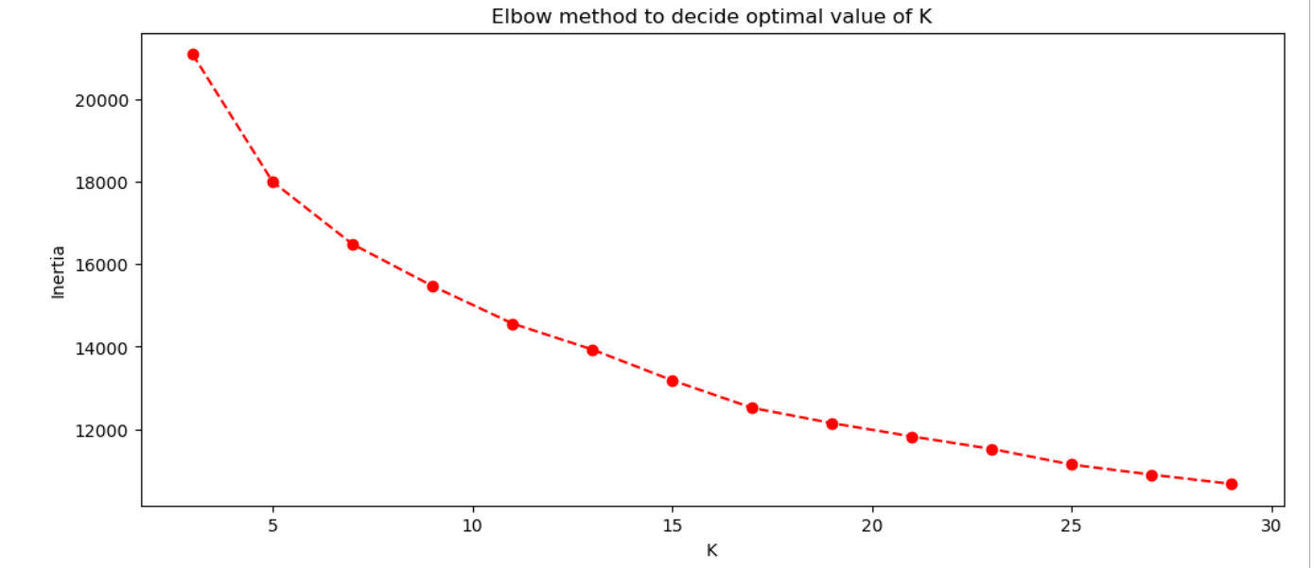
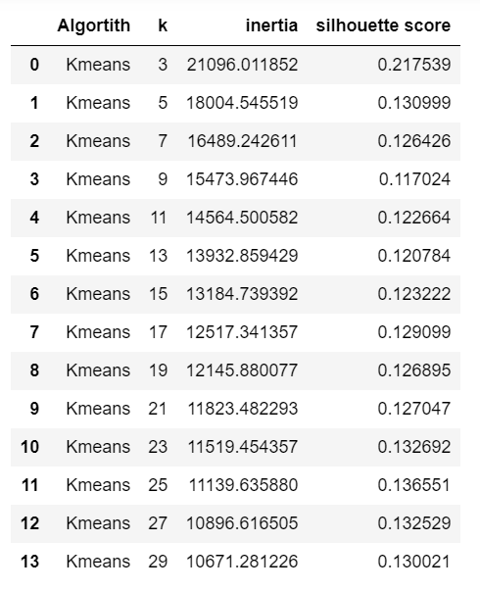
Customer Segmentation using K- means clustering

Slide 8
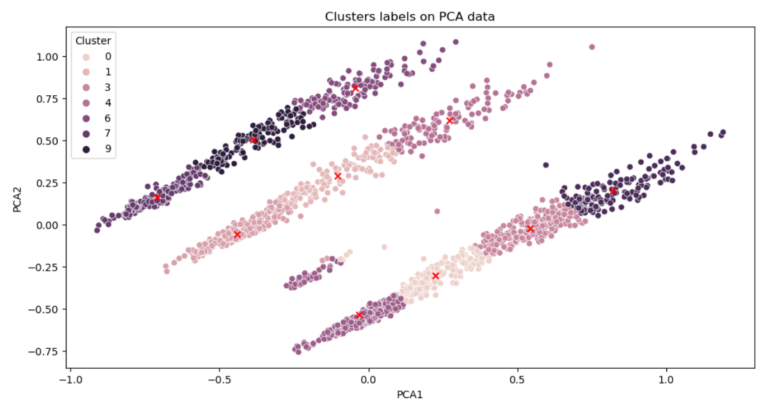
Customer Segmentation using K- means clustering

Slide 9
Next Steps & Conclusion
Investigate removed records (missing income & Age outlier)
Explore feature scaling
Explore Dimensionality reduction methods
Explore Segmentation algorithms
Cross validate segmentation with business to conclude the model performance.

Slide 10
Thank you.

